Slide 1

Service Manager - Cloudy with a chance of IaaS
Kurt Van Hoecke
Managing consultant Inovativ - MVP
Stijn Callebaut
Consultant Inovativ
Notes:
Good morning ☺

Slide 2
Session objectives
Introduction
Overview of the provisioning portals
Review the Microsoft solution set
Better together – System Center 2012 SP1
Notes:
Kurt
In this session we’ll talk about how the different provisioning portals targeting public and private clouds are positioned by Microsoft.
How can those portals be leveraged?
Throughout the session we’ll focus on the individual portal usage, their benefits and drawbacks.
We’ll conclude the session by leaving the portals as is and focus on the System Center product stack to deliver a complete solution addressing both needs.

Slide 3
1. Introduction
Notes:
Kurt
Before we start, let’s recapitulate what Microsoft defines as a Cloud.
A Cloud is:
a cloud is a visible mass of liquid droplets or frozen crystals made of water or various chemicals suspended in the atmosphere above the surface of a planetary body. ☺
A Cloud is by definition: a colloquial expression used to describe a variety of different computing concepts that involve a large number of computers that are connected through a real-time communication network (typically the Internet).
Clouds can consist of:
IaaS (infrastructure as a Service)
PaaS (platform as a Service)
SaaS (Software as a Service)
And even NaaS (Network as a Service), think network virtualization
And can be:
Public
Hybrid
private

Slide 4
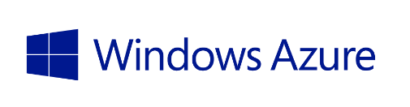
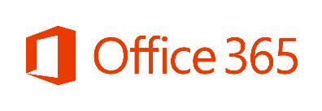


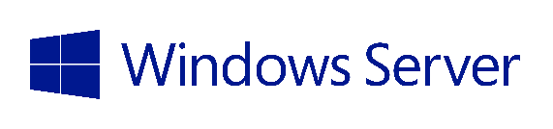
Microsoft Cloud OS Vision
Public Cloud
Azure Virtual Machines
Windows Azure Services
1
Windows Azure Services
Consistent
Platform
Private Cloud
Service Providers
Notes:
Kurt
Let’s take a step back and first defines how Microsoft sees the cloud:
We started of buying servers, installing applications on them and our datacenter kept growing, litteraly reaching its physical limits.
You just did not have enough room anymore to put servers.
That was the trigger for a new era: Virtualization for consolidation.
Let’s virtualize our servers so minimize the physical server footprint.
But still you threat your physical servers and virtual servers the same way.
You log on to them, install applications, enable features and keep on managing the same amount of servers.
Now comes in the cloud, what is the cloud is it running Windows Server, the MS Hypervisor and System Center?
NO
A cloud is about standardization; standarize your
hardware (everything runs on the same hardware, same make of servers,…)
processes (their is only one way to deploy a server,…)
your VM templates, (Small, Medium, Large) not 2 servers with 1gb of Ram and 1 core and 6 using 1.5gb of Ram and 2 cores,….
System Center, Windows server can enable that, but the cloud is more than just deploying those servers.
The focus shifts from deploying a server to support an application to deploying a serviceSSSSS we’ll start small, but if needed over time the service can scale out, and scale in whenever needed.
That brings us to the second tier of the MS Cloud.
Office365, depending on the appraoch Office 365 can be catalogued as a SaaS (small business) solution or the delivery of a Messaging and Collaboration Platform (PaaS)
Dynamics CRM online
Office 365 (see above)
Azure, a platform to host media services, website and more
Just a couple of months back during MMS, Microsoft added IaaS to its public cloud services.
You now have the possibility to deploy and manage virtual machines, storage and networks in the public cloud offering a range of possibilities.
If we look at the Private Cloud offerings/enablers, Microsoft has several products available, bundled in the well known System Center Suite relaying on MS SQL Server.
Using Service Manager, Orchestrator, Virtual Machine Manager and App Controller you are able to offer the same range of services towards your business as Microsoft offers in the public cloud.
When extending the Private cloud towards a client offering, mainly a service provider, Microsoft has made available Windows Azure Services, and Service Porvider Portal.
Has anybody already seen and or played with SPF?
As you will see throughout the session, the SPF exposes similar functionalities towards service provider clients as the azure portal. Clients will use the SPF portal and the System Center stack supporting the backend.

Slide 5

One Consistent Platform
Flexible development
Unified dev-ops and mgmt
Common identity and security
Integrated virtualization
Complete data platform
MICROSOFT
Azure
1
Cloud OS
ON-PREMISES
SERVICE
PROVIDER
Notes:
Stijn
One consistent platform, what does that involve…
Flexible development:
- Test environment – acceptance and production on same platform no mather where deployed
Unified dev-ops and mgmt.
- Unified interface to manage the environment – today still separated portals (we will tackle this in issue…)
Common identity and security
Integrated virtualization
Complete data platform
Step in to the info to go over to next slides…Portals

Slide 6
VM Provisioning landscape in the cloud
Windows Azure portal
“One Stop Shop” for Cloud Services and Management
Target Azure public cloud
Windows Azure Services for Windows Server
Rich IaaS experience for self-service provisioning of Virtual Machines hosted on Windows Server and System Center 2012
System Center Orchestrator
Runbook automation
Notes:
Stijn + Kurt + Stijn
What are our options?
The azure portal
Windows Azure Services for Windows Server (comes with the Orchestrator sources) and enables similar services towards our business clients as the azure portal, relying on the System Center stack
And let’s not forget Orchestrator as the automation tool available in the System Center Suite.
Using Orchestrator you can define workflows to deploy Virtual Machines into your cloud using different integration packs like
Windows Azure,
System Center Virtual Machine Manager
the system integrationpack containing the “Run program” activity and the “Run .net activity”
If you like to have some more information about orchestrator best proactices, make sure to attend the session later today by Valerie & Jan.

Slide 7
Provisioning portals
DEMO
Notes:
Let’s have a look at the 2 provisioning portals made available by Microsoft.
And don’t forget the, rather limited, Orchestrator Web Console, wich you can also use to start runbooks.
If Orchestrator is to limited and Service Manager is not an option, or to have weighted, some Microsoft Partners might have solutions fitting your need.

Slide 8
2. Challenges
Notes:
Kurt

Slide 9
Problem statement
Consistent platform, but each has its own target cloud.
No Process integration in the request to create new VM’s
Deployment too many steps? Too many clicks?
Notes:
Kurt

Slide 10
3. Better together!

Slide 11
Example scenario
We take Service Manager into the environment
Service request in SCSM to request VM
Based on selected type of VM (Test/Production) target cloud is selected.
Approval is required before provisioning of the VM(s)
Both public (Azure) and private cloud (SCVMM) requests via one portal.
Follow-up of the request must be possible via portal
Notes:
Kurt

Slide 12
Better together!
DEMO
Notes:
Stijn

Slide 13
Windows Azure + Orchestrator + SCSM + SCVMM
Better Together
Removes much of the complexity of managing Windows Azure features & resources
Removes cloud selection via predefined policies
Service Request Process integration. Ability to integrate approvals and record all requests history.
Automated Deployment
Go from a “record” in a database – To Cloud Services Virtual Machine Deployment
Based on input provided the requested VM is provisioned to Azure or SCVMM
Automated Deprovisioning
Worried about leaving resources deployed/running?
Worry no more! Automated deprovisioning of resources is one click away!
Notes:
Kurt

Slide 14
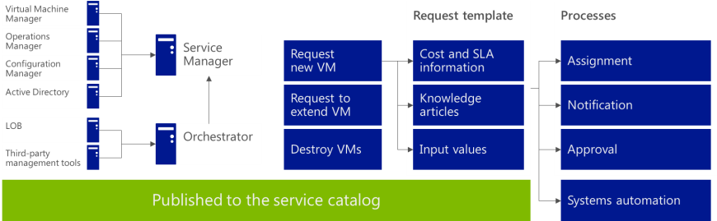
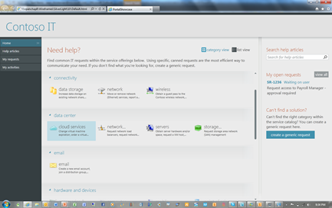
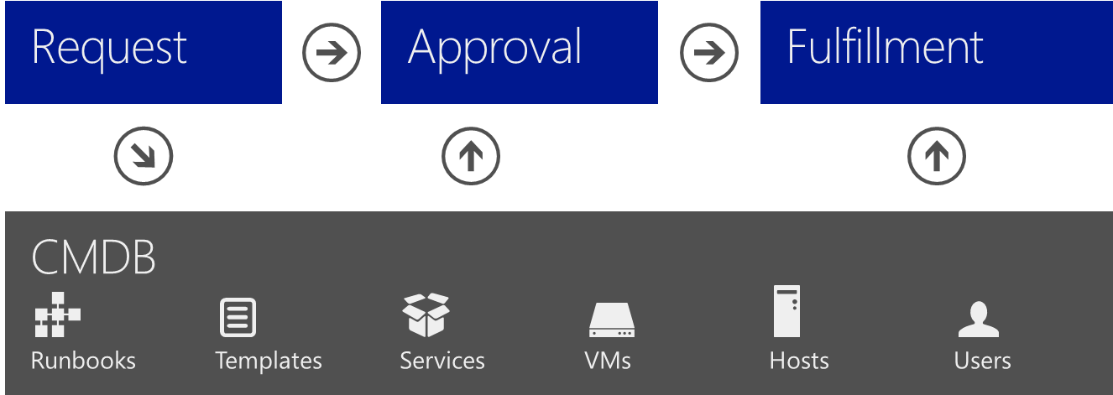
Deploy service delivery and automation
Standardization
Self-service
Automation
Standardize the services provided by IT to consumers
Define the services to be offered
Define the request offerings that will be contained within a service offering
Identify who needs to be involved (approvals, notifications, fulfillment)
Give consumers of IT services the ability to identify, access, and request services as needed
Controlled empowerment
Request offerings displayed based on user role
Intuitive, easy-to-navigate portal
Automate the service processes and systems necessary to the fulfillment of consumer requests
Automate routing of requests for approval and notification
Automate provisioning of the service request
Notes:
Kurt

Slide 15
Proactive processes
Event mgmt
Close
request
Benefits
Improved SLA support
Supports compliance
Process traceability
Improved productivity
Captures best practices
Improved operational ROI
Service desk
Monitor
for error
Update
CMDB
Asset/CMDB
Initiate
change
Associate server to service
Configuration
Create
deployment
Standard operating procedures
Disaster recovery procedures
Virtual
Change and compliance
VM to
maintenance
Provisioning
Security
Storage
Create
extra disk
Connect
disk to VM
Server
Update
server
Network
Configure
network
Notes:
Kurt

Slide 16
Orchestrator Automation
Microsoft and 3rd party support
Microsoft IPs
Operations Manager
Virtual Machine Manager
Data Protection Manager
Service Manager
Configuration Manager
Active Directory
In Box IPs
System
Scheduling
File Management
Text File Management
Email
Utilities
3rd Party Support
VMware vSphere 4.1 and 5
IBM Netcool 7.3
HP Operations Manager 9.x on platforms supported by HP web services
HP Service Manager 7.11 and 9.x on platforms supported by HP web services.
HP iLO & OA supporting iLO2 and iLO3 and OA firmware 3.21
Exchange (User/Admin)
Sample community IPs on Codeplex:
Team Foundation Server
PowerShell
SharePoint
Active Directory
Configuration Manager 2007
Exchange Mail and Exchange Calendaring
Local Security
Scheduled Tasks
Utilities
VMWare
F5
Notes:
Kurt

Slide 17
3. Better together! Solution overview
Notes:
Kurt

Slide 18
Demo components overview
DEMO
Notes:
Stijn

Slide 19
More possible scenarios…
Move service from On-Prem to the Public Cloud
Runbooks to backup or move VMs away from On-Prem resources to Cloud Resources
Move service from the Public Cloud to On-Prem
Runbooks to download VMs from the Cloud to On-Prem resources
From Windows Azure to the rest of System Center 2012 SP1
The Public Cloud is just a few simple steps from On-Prem Management
Runbooks connecting Operations Manager, Service Manager, Virtual Machine Manager and Configuration Manager
Test lab provisioning
Imagine, single click and you deploy a complete lab environment.
Automated scale-in and scale-out scenarios
Notes:
Stijn

Slide 20
Key Takeaways
Each cloud solution has its own provisioning portal.
With System Center you can have a unified way to target both
Quick start: 21 Azure Example Runbooks Available (with Video Demonstration)! http://blogs.technet.com/b/building_clouds/archive/2013/02/22/automation-orchestrating-windows-azure-solving-the-public-cloud-puzzle-with-system-center-2012-sp1.aspx
Integrate human & system processes
Service Manager for human processes
Orchestrator for system automation

Slide 21
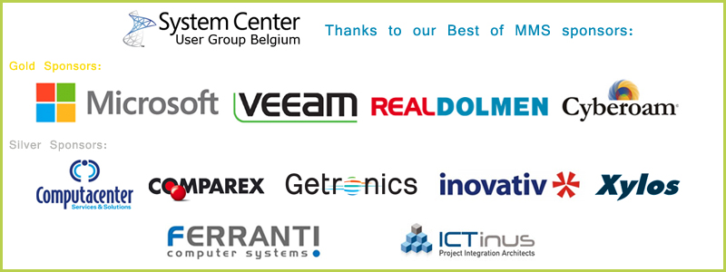
Thank You to our SPONSORS
Notes:
Stijn

Slide 22
Follow us
Visit our blog: http://www.scug.be/SCSM
Check us out on Twitter: @BunkCo
Learn More!
Watch our development: http://www.AuthoringFriday.com
Send us an email: info@inovativ.be
Notes:
Kurt

Slide 23
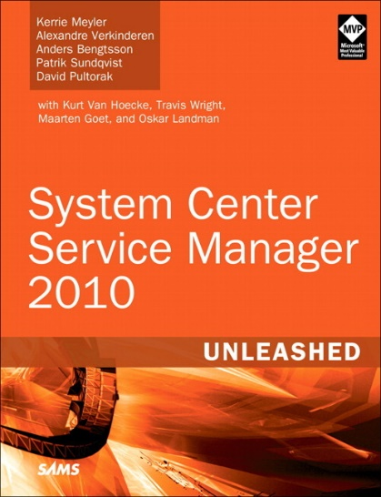
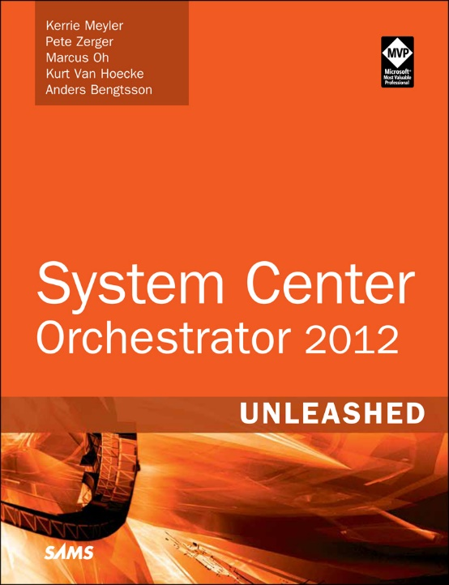
Unleashed series
System Center Service Manager 2010 Unleashed
System Center Orchestrator 2012
Unleashed (Release July)
System Center Service Manager 2012 Unleashed (Release Q4)
Notes:
Kurt

Slide 24
Q and A

Slide 25

© 2013 Microsoft Corporation. All rights reserved. Microsoft, Windows and other product names are or may be registered trademarks and/or trademarks in the U.S. and/or other countries.
The information herein is for informational purposes only and represents the current view of Microsoft Corporation as of the date of this presentation. Because Microsoft must respond to changing market conditions, it should not be interpreted to be a commitment on the part of Microsoft, and Microsoft cannot guarantee the accuracy of any information provided after the date of this presentation. MICROSOFT MAKES NO WARRANTIES, EXPRESS, IMPLIED OR STATUTORY, AS TO THE INFORMATION IN THIS PRESENTATION.

